Slide 1
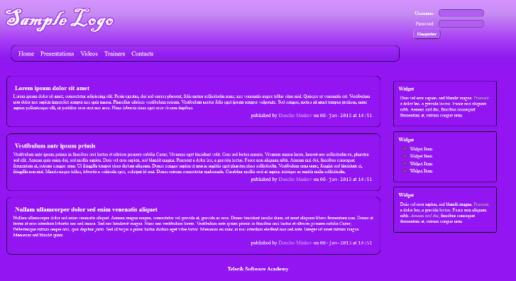
Implement the following using SASS
Use the HTML code from index.html
Create the SASS easy to change (backgrounds, fonts); Use mixins for clears, gradients

Slide 2
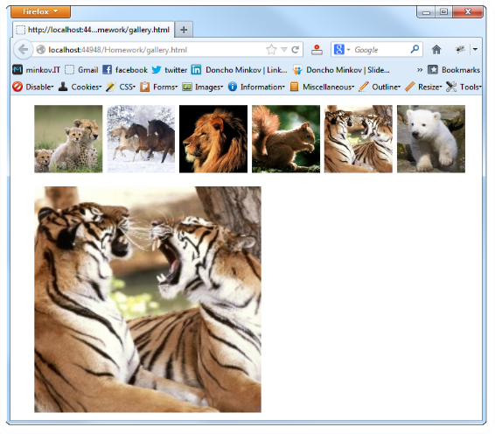
Create a web gallery by using only HTML, SASS and CSS; List images; When a image is selected, show it zoomed

